Slide 1
Best graphic design programs

Slide 2
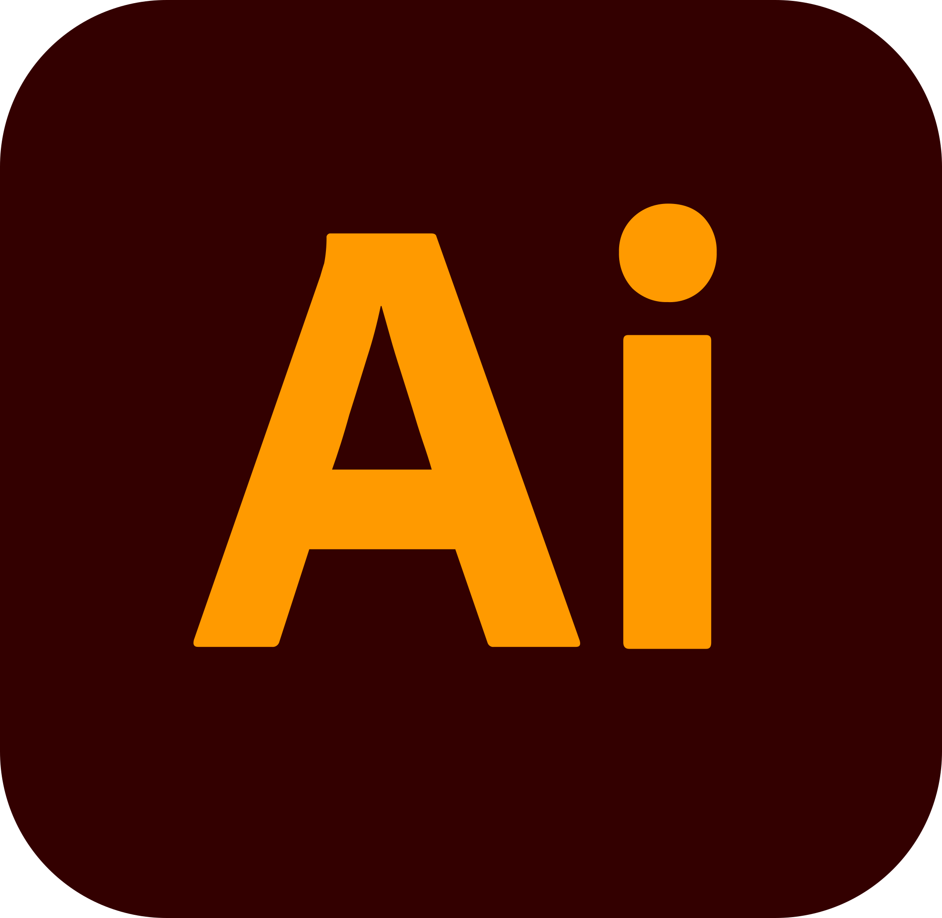
Adobe Illustrator
Category: Vector graphics
Features: Templates, blank document presets, workspaces for touch-enabled devices, sync with InDesign
What it’s best for: Designing vector graphics that can be scaled larger or smaller without affecting image quality
Cost: $20.99 / month

Slide 3
Adobe Illustrator
What is it most used for?
- Its used for creating a variety of digital and printed images, including cartoons, charts, diagrams, graphs, logos, and illustrations.

Slide 4

Adobe InDesign
Category: Desktop publishing
Features: Templates, blank document presets, workspaces for touch-enabled devices, sync with Illustrator
What it's best for: Creating long-form multi-page documents, such as books, magazines, reports, or brochures
Cost: $20.99 / month

Slide 5
Adobe InDesign
What is it used for?
-Its used for print and digital media, such as flyers, posters, stationary, slideshows, and more.

Slide 6
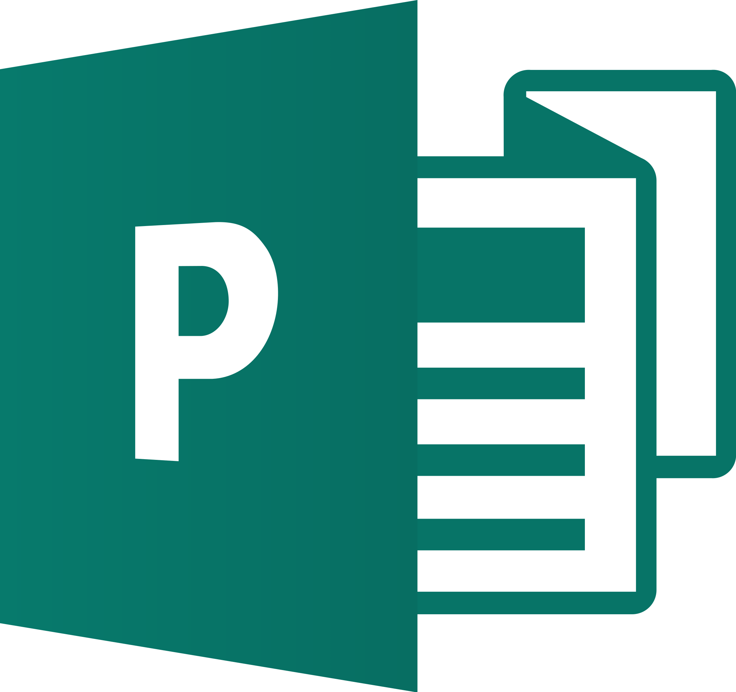
Microsoft Publisher
Category: Desktop publishing
Features: Pre-designed templates for creating greeting cards, yearbooks, email newsletters, etc.
What it's best for: Precise layouts and styling for professional publications
Cost: $159.00 one-time fee

Slide 7
Microsoft Publisher
Where is it avabile?
-Its only avabile on windows
What is it used for?
-Its used for creating visually rich, professional-looking publications.

Slide 8
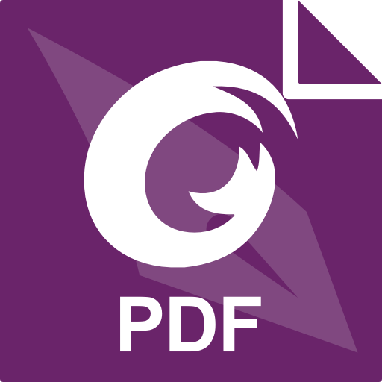
Foxit PDF Editor
Category: File converter, PDF editor, document creation, e-signature, desktop publishing
Features: Advanced PDF editing, automated workflows, embedding media capabilities, document protection and security
What it's best for: Creating, editing, filling, and e-signing documents from one app
Cost: $159.00 one-time fee

Slide 9
Foxit PDF Editor
Where is it avabile?
-Available on Windows and on macOS
What is it used for?
-Its used for creating, editing sharing, collaborating, exporting, organization, accessibility, security, scanning and more.

Slide 10
Thank you for your attention!

